Slide 1
Parallelism

Slide 2
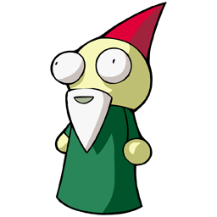

Tasks + Work Stealing in Dinamica EGO 5
The execution runtime has a predefined number of available workers. Each worker can run a single task at a time
Tasks represent a piece of work
The execution of a task can result in the creation of more tasks. They can pause their execution at any time and become dependent on some other tasks
Workers that can not find tasks to run are considered “idle”

Slide 3
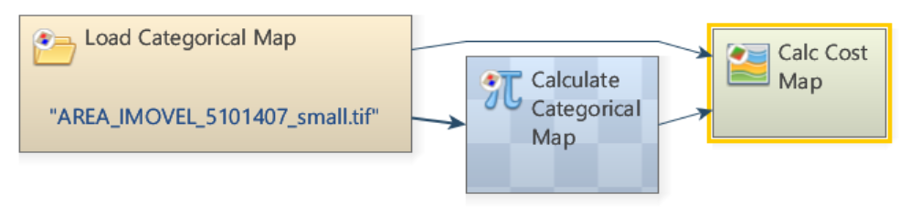
Tasks + Work Stealing in Dinamica EGO 5
Model

Slide 4

Tasks + Work Stealing in Dinamica EGO 5
The execution starts with a single task (A) responsible for running the model script
A
Grumpy
Sleepy
Sneezy
Happy
Workers

Slide 5
Tasks + Work Stealing in Dinamica EGO 5
Yay! I have some work to do!
A
I could not find any work, so I am voting for termination
Grumpy
I could not find any work, so I am voting for termination
I could not find any work, so I am voting for termination
Sleepy
Sneezy
Happy

Slide 6

Tasks + Work Stealing in Dinamica EGO 5
A
Grumpy
The worker responsible for the execution of the task (A) follows the task instructions …
Sleepy
Sneezy
Happy

Slide 7


Tasks + Work Stealing in Dinamica EGO 5
A
B
Dependency
Suspended Task
Grumpy
The task (A) creates a new task (B) for each independent functor and pause its own execution
Sleepy
Sneezy
Happy

Slide 8
Tasks + Work Stealing in Dinamica EGO 5
A
B
Dependency
Suspended Task
Grumpy
The new task (B) becomes available for any other available worker, and can be “stolen” at any time
Sleepy
Sneezy
Happy

Slide 9

Tasks + Work Stealing in Dinamica EGO 5
A
Dependency
B
The worker responsible for the execution of the new task (B) follows the task instructions and creates new tasks (C, D, E, F, G & H) for loading pieces of a map from the disk
H
F
Sleepy
G
C
E
D
I can not find any work, so I am also voting for termination
Grumpy
Sneezy
Happy

Slide 10
Tasks + Work Stealing in Dinamica EGO 5
A
H
F
Dependencies
C
G
B
E
D
The workers start “stealing” tasks from the group of newly created tasks
Grumpy
Sleepy
Sneezy
Happy

Slide 11
Tasks + Work Stealing in Dinamica EGO 5
A
H
F
Dependencies
G
B
E
D
Grumpy
Sleepy
C
Sneezy
Happy

Slide 12
Tasks + Work Stealing in Dinamica EGO 5
A
H
F
Dependencies
G
B
E
Grumpy
D
Sleepy
C
Sneezy
Happy

Slide 13
Tasks + Work Stealing in Dinamica EGO 5
A
F
Dependencies
G
B
E
Grumpy
D
Sleepy
C
Sneezy
H
Happy

Slide 14
Tasks + Work Stealing in Dinamica EGO 5
A
F
Dependencies
G
B
Grumpy
D
Sleepy
C
Sneezy
H
Happy
E

